Slide 1
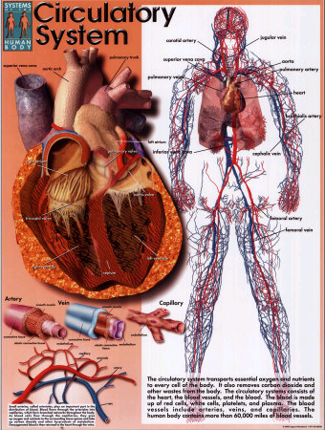
The
Circulatory
System

Slide 2
How large is the heart?
The average heart is the size of an adult fist.

Slide 3
Objective:
Understand the circulatory system is structured to facilitate the transport of materials through the body

Slide 4
Circulatory System
Major Structures:
  Heart
  Blood
  Blood vessels
Primary functions:
  Transports nutrients and oxygen to body cells and removes waste products.

Slide 5
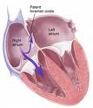
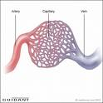
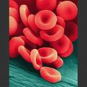
Three Main Parts of the Circulatory System
The Heart | The Blood Vessels | The Blood
4 chambers: The left atrium The left ventricle The right atrium The right ventricle | Arteries Veins Capillaries | Red blood cells White blood cells Platelets Plasma

Slide 6
The Heart:
The heart facilitates the efficient flow of blood around the body

Slide 7
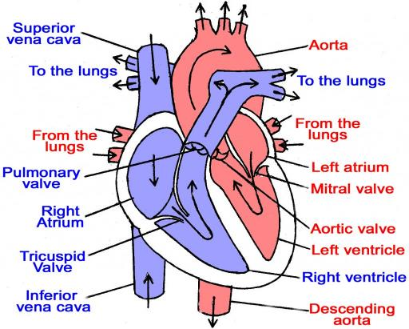
The human heart

Slide 8
How fast does your heart beat?
Your heart will beat about 115,000 times each day.

Slide 9
What Volume of blood is pumped per day?
Each day, your heart pumps about 7,500 litres of blood.

Slide 10
Blood Vessels in the Heart
 | Carries | From | To
Vena cava | Deoxygenated blood | The body | Right atrium
Pulmonary artery | Deoxygenated blood | Right ventricle | The lungs
Pulmonary vein | Oxygenated blood | The lungs | Left atrium
Aorta | Oxygenated blood | Left ventricle | The body

Slide 11
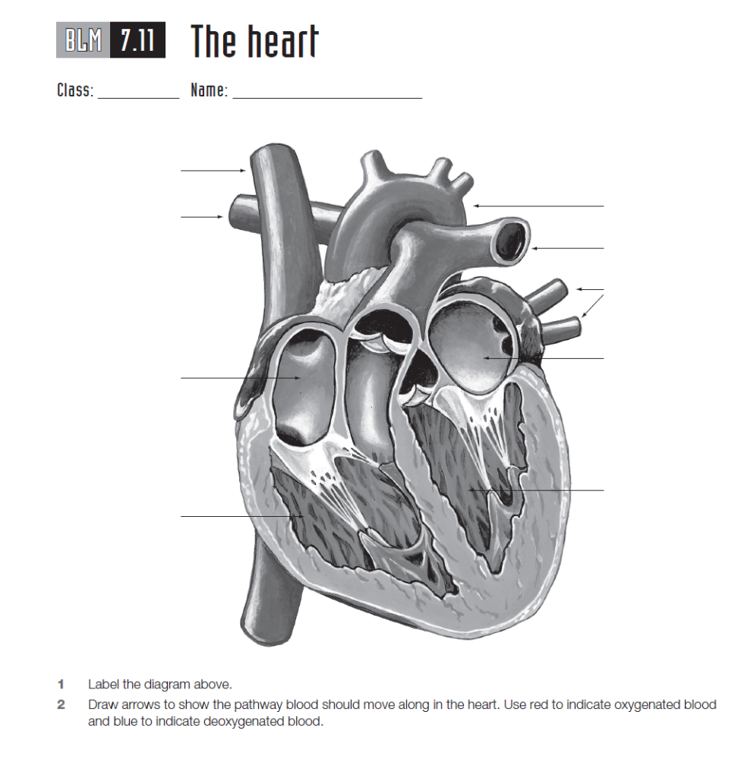
Label the heart diagram on your sheet including the chambers and blood vessels
Add the flow of the blood on your diagram using red(high O₂) and blue (low O₂) arrows

Slide 12
https://www.youtube.com/watch?v=_vZ0lefPg_0

Slide 13
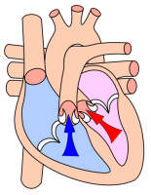
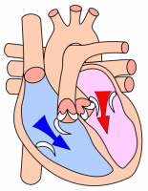
The flow of Blood through the heart

Slide 14
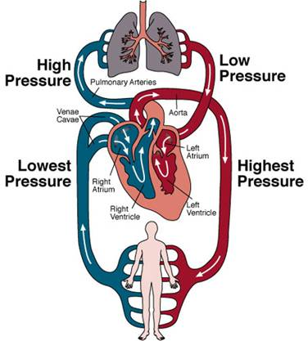
Blood
Flow
Around the
Body
Lungs
Pulmonary vein
Body

Slide 15
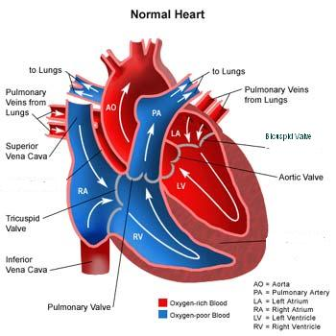
Need to be able to:
1. Label the chambers in the heart.
2. Indicate the direction of blood flow around the heart.
3. Label where the blood is coming from and where it goes to (eg head, lungs).
4. Colour the area with oxygenated blood in red.
5. Colour the area with deoxygenated blood in blue.
(Bicuspid Valve)

Slide 16
Animal Heart Trivia
A hummingbird’s heart rate can reach up to 1,000 beats per minute in some species
A blue whale’s heart weighs about 800 kilograms
A cheetah’s heart rate can speed up to 250 beats per minute within seconds
Octopuses have three hearts
The Zebrafish can regenerate their hearts
A seal’s heart rate can go as low as 10 beats per minute during an extended underwater dive

Slide 18
WALT
Understand that the blood vessels of the circulatory system are specialised structures that provide for efficient distribution and collection of blood around the body

Slide 19
Main Vessels in the Circulatory System
Vessel | Structure of vessel wall | Function
Artery | Thick-walled and muscular | Carry blood to organs
Capillary | Very thin walls, only 1 cell thick | Allows materials to pass from blood to cells and cells to blood.
Vein | Thin-walled with valves | Carry blood back to the heart.

Slide 20
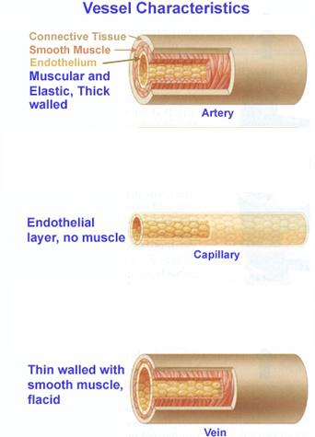
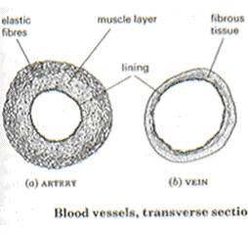
Cross Sections

Slide 21
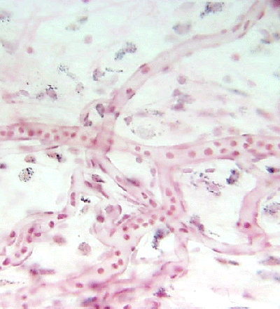
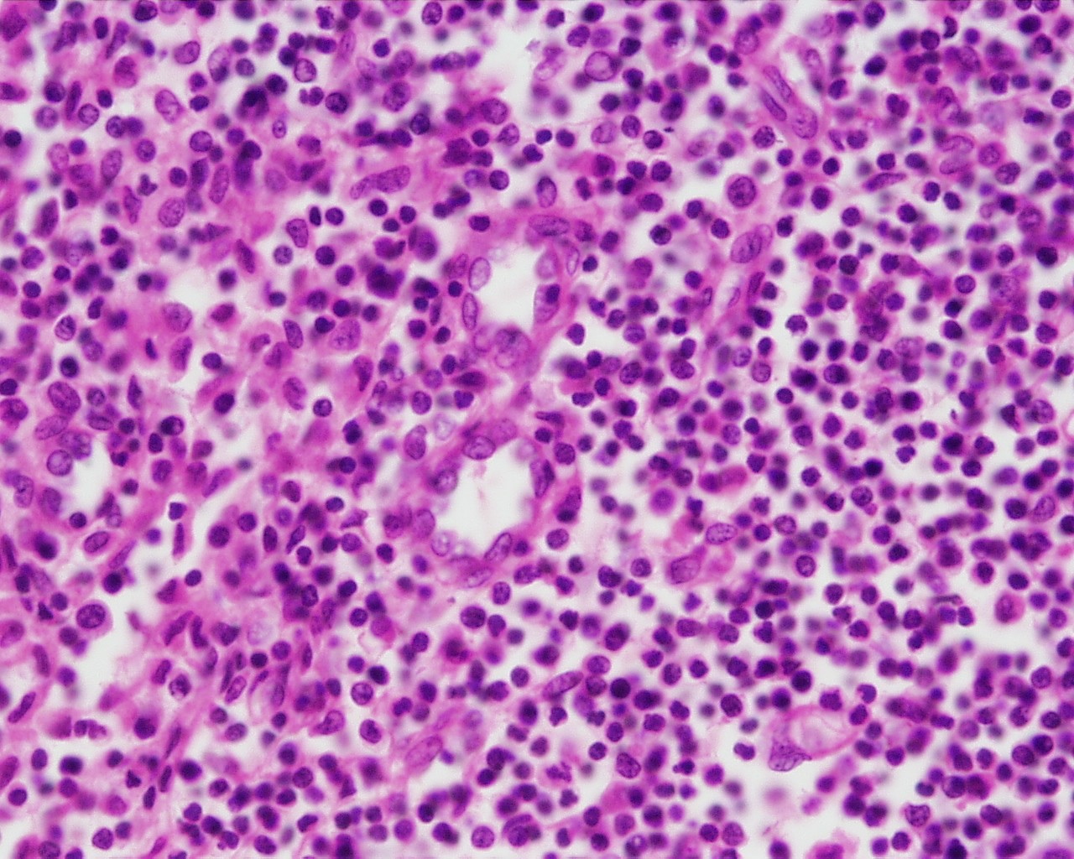
Capillaries
Capillary
G. Meyer – ANHB, UWA
L. Slomianka – ANHB, UWA

Slide 22
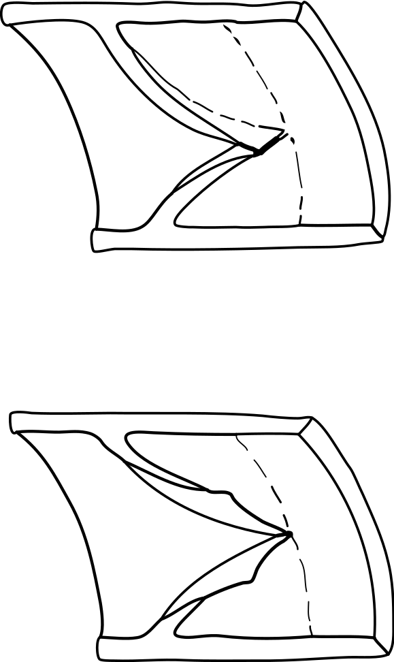
Veins contain valves to prevent the back flow of blood
Valve open
Valve closed

Slide 23
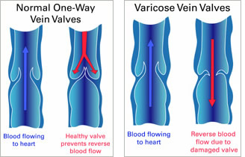

Slide 24
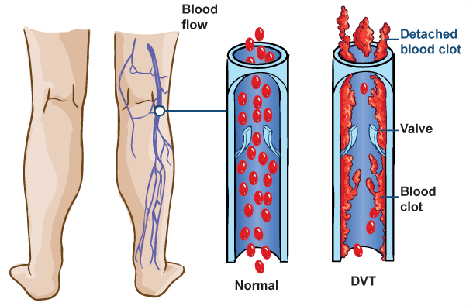

Slide 25
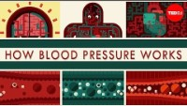

Slide 26
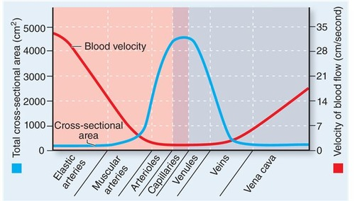

Slide 27
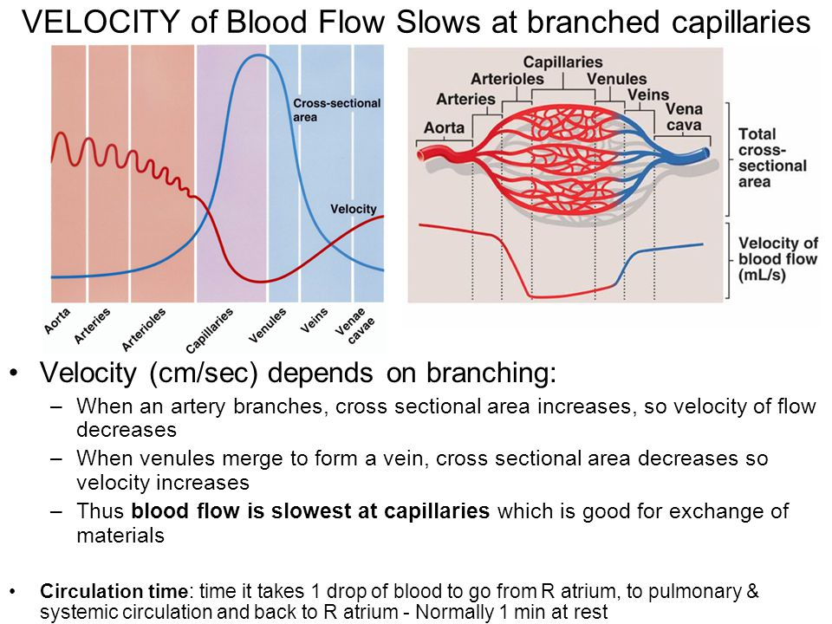

Slide 28
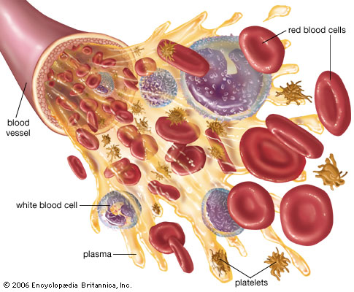
Blood Cells

Slide 29
WALT:
Understand that the blood is made up of plasma and blood cells, each with particular functions that aid in the:
transport of materials, including oxygen, nutrients and waste
defence against pathogens

Slide 30
The Main Components of Blood
Component | Function
Plasma (55%) | Transport of: Oxygen Digested food Carbon dioxide Wastes Hormones Salts Heat
Blood Cells (45%) Red blood cells White blood cells Platelets | Carry oxygen Protect the body Clotting of the blood

Slide 31
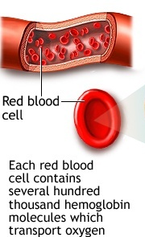
Red Blood cell
Life Span = 120 days
. No Nucleus present to save space for carrying oxygen & to go through narrow spaces and capillaries.
Haemoglobin is present to attach to oxygen.

Slide 32
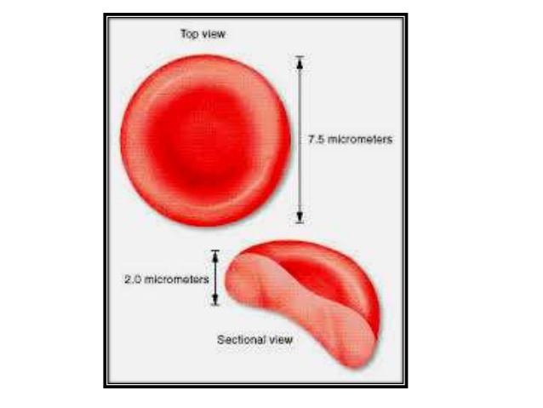

Slide 33
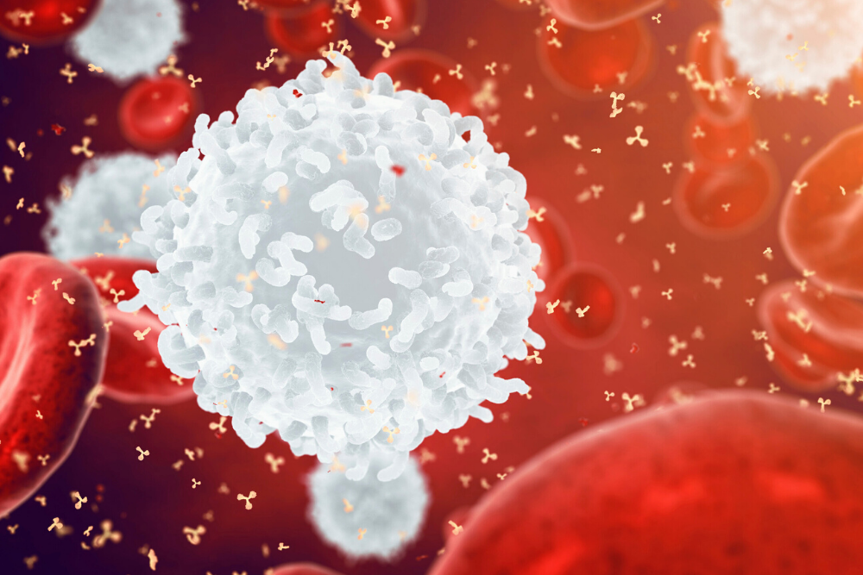
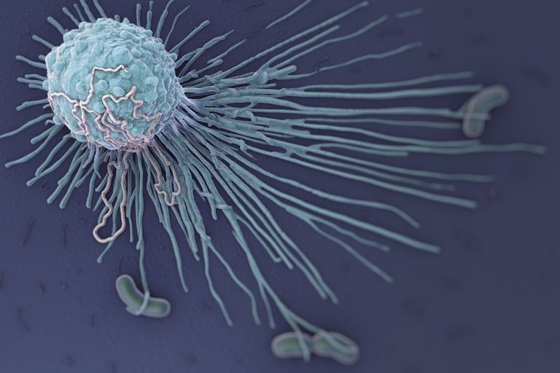
White Blood Cells
Fights infections and foreign substances by engulfing and destroying them (phagocytosis).
Shape varies so that they can squeeze between cells in the tissues.

Slide 34
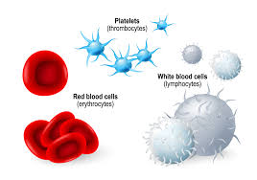
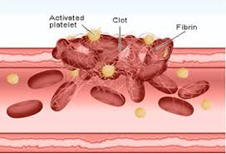
Platelets
Irregular shape to help in clotting blood to stop bleeding.

Slide 35
WALT:
Understand that the function of the circulatory system can be compromised by cardiovascular diseases that reduce the efficiency of transport of materials around the body

Slide 36
Disease of the circulatory system
Hypertension
Arteriosclerosis
Angina
Heart attack
Stroke
Peripheral vascular disease

Slide 37
Functioning Body Systems
How does the circulatory system work with other body systems?

Slide 38
Answer:
The circulatory system works with the respiratory system to provide oxygen to cells;
It works with the urinary and digestive systems to remove waste products;
It helps give skin colour;
It is under control of the nervous system.

